Slide 1

Resume Analyzer/Parser

Slide 2


Business objective
The document classification (Resume Analyzer/Parser) solution should significantly reduce the manual human effort in the HRM. It should achieve a higher level of accuracy and automation with minimal human intervention

Slide 3
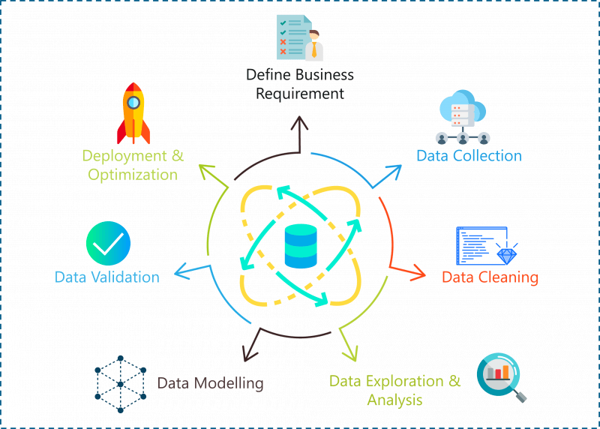

Slide 4

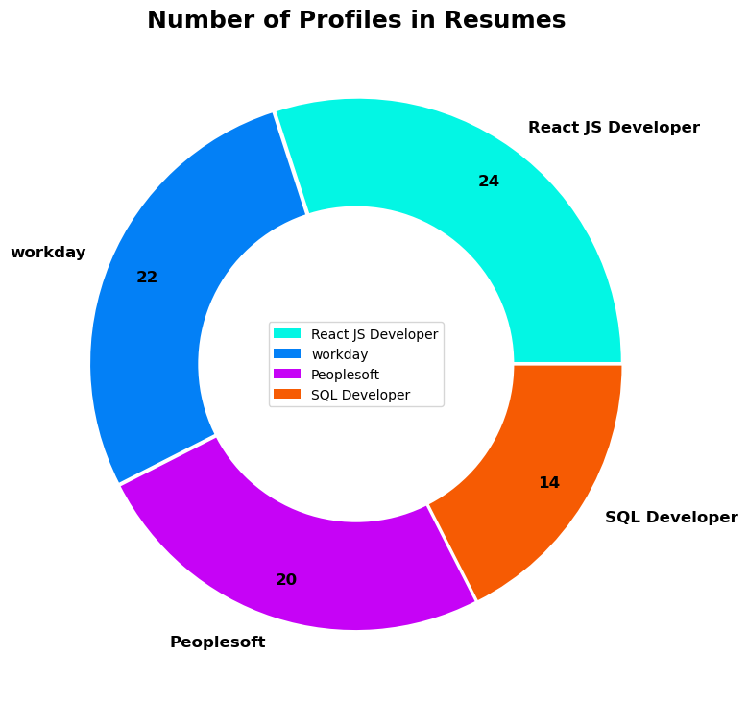
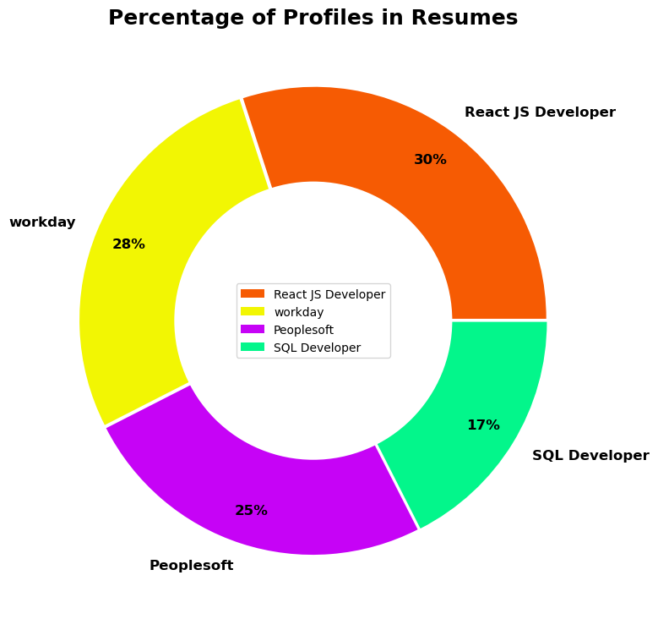
EDA

Slide 5
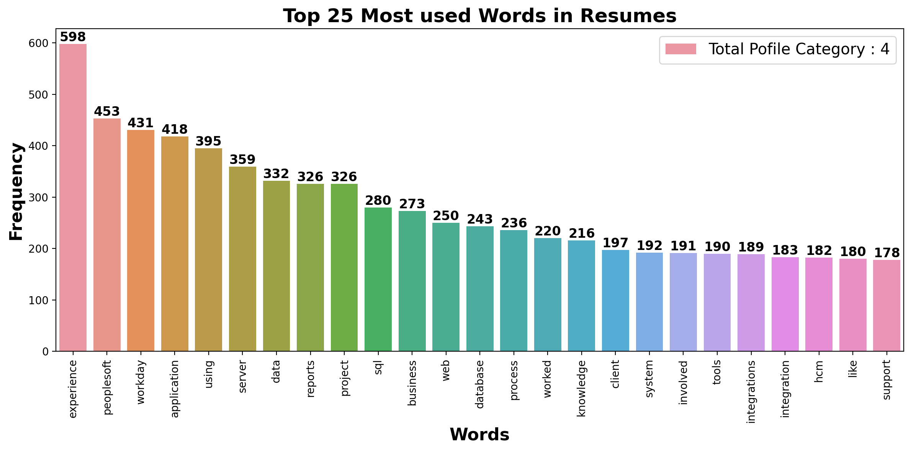
EDA

Slide 6
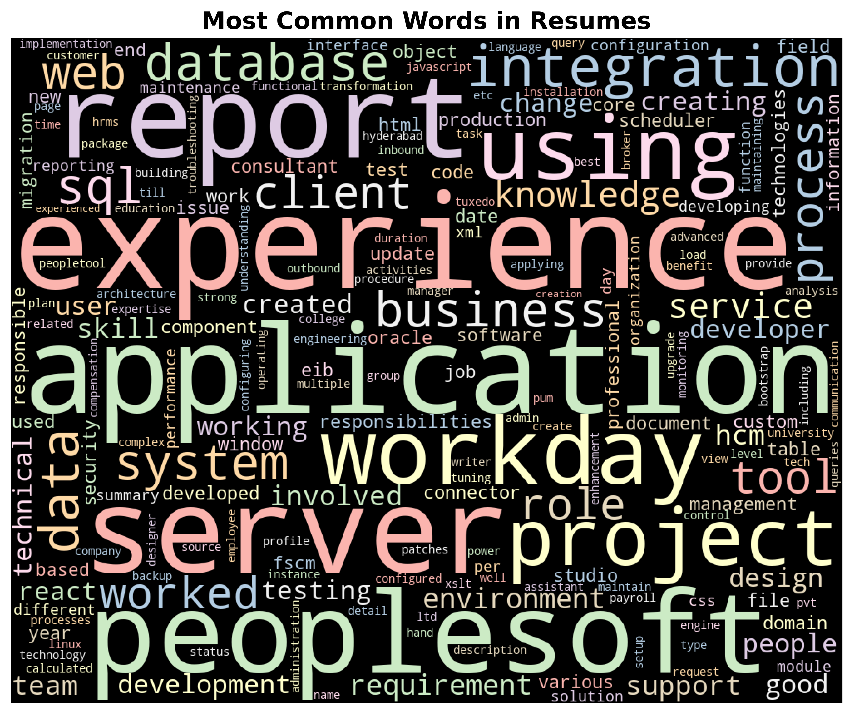
EDA

Slide 7
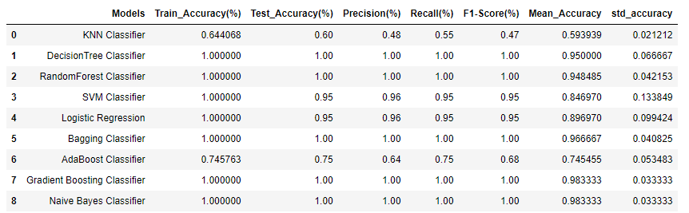
Model building

Slide 8
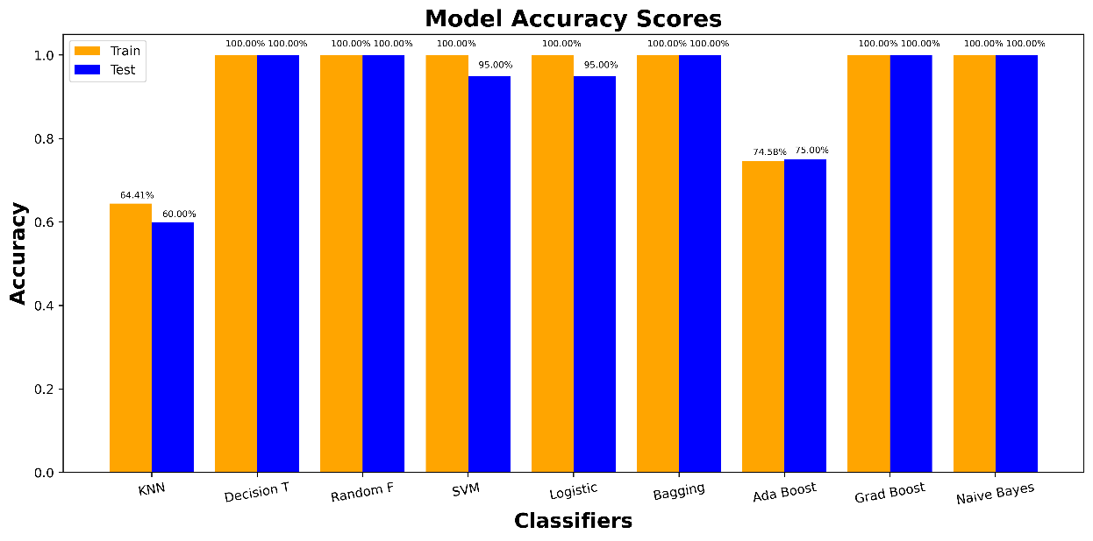
Train Test Accuracy plot

Slide 9
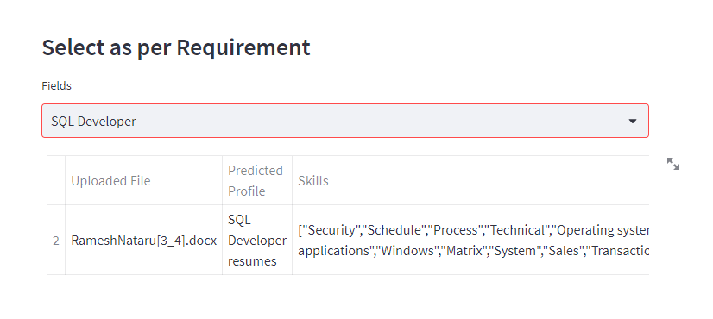
Deployment

